Slide 1
LEADERSHIP II FOR FIRE AND EMS: STRATEGIES FOR PERSONAL SUCCESS ENHANCING YOUR PERSONAL POWER BASE

Slide 2
OBJECTIVES
The students will:
Identify five types of power.
Identify the sources and limits of different types of power.
Differentiate between use and abuse of different types of power.
Explain how influencing and networking can complement one's power base.
Identify potential activities for enhancing their power base.
Begin to develop a Personal Power Enhancement Plan.

Slide 3
OVERVIEW
Definition and Importance of Power
Who Has Power?
Types of Power
Sources and Limits of Power
Analyzing Appropriate Use and Abuse of Power
Power Skills
Increasing Your Power Base
Personal Power Enhancement Plan

Slide 4
How would you define power? How do you feel about power?

Slide 5
DEFINITION AND IMPORTANCE OF POWER
Definition: Power is being able to influence the attitudes and/or behaviors of others.

Slide 6
DEFINITION AND IMPORTANCE OF POWER (cont'd)
Power is:
– Not good or bad, not moral or immoral
– Neutral skill which can be used effectively or abused
– Ability to get others to do what you want!

Slide 7
DEFINITION AND IMPORTANCE OF POWER (cont'd)
Relationship to leadership
– Appropriate use of power is an essential leadership skill
– Leadership is influencing others toward the accomplishment of organizational goals
– Leadership requires using power to influence others

Slide 8
RELATIONSHIP OF POWER TO LEADERSHIP
Effectiveness dependent on cooperation of others:
– Subordinates
– Peers
– Superiors
Minimize dependency by establishing power

Slide 9
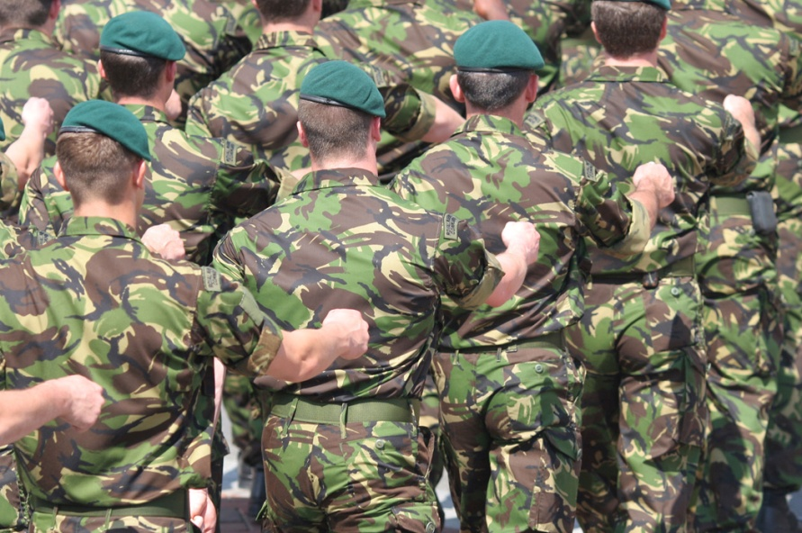
DEFINITION AND IMPORTANCE OF POWER (cont'd)
Obligations of power
– Submission
– "Power-person" has obligation to recognize submission and protect those being influenced.

Slide 10
DEFINITION AND IMPORTANCE OF POWER (cont'd)
Ethical uses of power exclude:
– Exploiting others
– Influencing others to illegal or immoral conduct
– Reducing others' self-esteem
Positive power usage assumes
– Sensitivity to others
– Preference for win-win solutions
– Effective interpersonal skills

Slide 11
Who are some individuals that you perceive as powerful? In what ways do these people demonstrate their power?

Slide 12
TYPES OF POWER
Formal power:
– Tied to your official position.
– Position guarantees level of authority.
– Within your level you can direct or order.
– Higher position yields more power.
– People believe you have the right to tell them what to do and they have an obligation to do it.

Slide 13
What is an example of formal power from the posted list of power examples?

Slide 14
TYPES OF POWER (cont'd)
Reward power
– Ability to give rewards in exchange for compliance
– Rewards can be official or informal
– Must be meaningful and desired
– Others comply to get the reward

Slide 15
What is an example of reward power from the posted list of power examples?

Slide 16
TYPES OF POWER (cont'd)
Coercive power
– Ability to punish for noncompliance
– Opposite side of coin from reward power
– Punishments can be official or informal
– Punishments must be meaningful
– Compliance to avoid punishment

Slide 17
What is an example of coercive power from the posted list of power examples?

Slide 18
TYPES OF POWER (cont'd)
Expert power:
– Having more knowledge and using this to your advantage.
– Must not only be an expert, but be aware of your expertise.
– Others comply because they respect your expertise.

Slide 19
What is an example of expert power from the posted list of power examples?

Slide 20
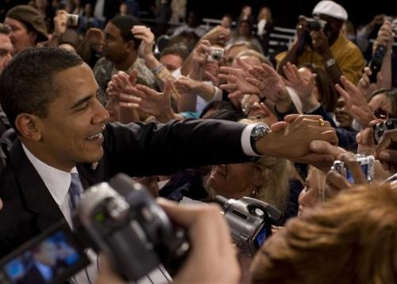
TYPES OF POWER (cont'd)
Referent power
– Liked, admired, and trusted by others.
– Using charisma to your advantage.
– Others comply to please you and to get your personal approval.

Slide 21
What is an example of referent power from the posted list of power examples?

Slide 22
SOURCES AND LIMITS OF POWER
Two basic sources:
Ascribed
Achieved

Slide 23
SOURCES AND LIMITS OF POWER (cont'd)
Ascribed or position power:
Given by virtue of position.
Rank determines amount of formal, reward, and coercive power you possess.
Compliance to position power is based on required acceptance.
Subordinates comply because they must.

Slide 24
What is an example of formal, reward, and coercive power available to Company Officers (COs)?

Slide 25
SOURCES AND LIMITS OF POWER (cont'd)
Achieved or personal power is earned
Expert and referent
No guarantee of these powers.
With no position power, can still develop large powerbase
Earn personal power
Subordinate compliance is based on respect and/or admiration for you
Subordinates comply because they want to!

Slide 26
What are some personal examples of expert and referent power at the CO level?

Slide 27
TYPES OF POWER (cont'd)
Limits:
– Formal, reward, and coercive power generally only work on subordinates.
– Formal power is limited by scope of authority.
– Reward power is limited by desirability of reward.
– Overuse of coercive power leads to covert resistance.
– Expert power is limited by others' perception of the importance/usefulness of the area of expertise.

Slide 28
TYPES OF POWER (cont'd)
Other facts:
– Expert and referent powers work in different directions.
– Individuals with low self-confidence rely more on formal and coercive powers.
– Effective leaders rely on referent and expert powers.

Slide 29
TYPES OF POWER (cont'd)
Compliance in visible; routine tasks can be influenced by formal power alone. Less visible, more creative tasks require referent or expert powers.
The more sophisticated/self-confident/capable individuals are apt to be more influenced by expert and referent powers.
Use of power expends some of a limited source of energy--the more you use, the more you lose!

Slide 30
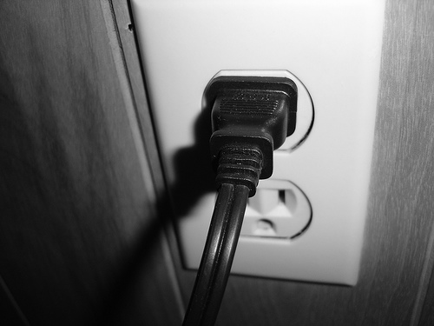
TYPES OF POWER (cont'd)
Anticipating outcomes
– Five power types can produces various responses.
– Effective leader uses power sparingly.

Slide 31
USING DIFFERENT POWER TYPES AND LIKELY OUTCOMES
TYPE OF POWER | TYPES OF OUTCOMEs
 | Commitment | Compliance | Resistance
Referent power | LIKELY If request is believed to be important to leader. | POSSIBLE If request is perceived as unimportant to leader. | possible If request is perceived as harmful to leader.
Expert power | LIKELY If request is persuasive and subordinates share leader's goals. | POSSIBLE If request is persuasive but subordinates don't care about goals. | POSSIBLE If leader is arrogant or insulting, or subordi- nates oppose goals.
Formal power | POSSIBLE If request is polite and appropriate. | LIKELY If request is seen as appropriate. | POSSIBLE If request is arrogant and/or inappropriate.
Reward power | POSSIBLE If used in a subtle, very personal way. | LIKELY If used in a routine, impersonal way. | POSSIBLE If used in a manipulative, arrogant way.
Coercive power | VERY UNLIKELY Regardless of how it's done! | POSSIBLE If used in a helpful, nonpunitive way. | LIKELY If overused or used in a hostile or manipulative way.

Slide 32
Activity PP.1 Analyzing Appropriate Use and Abuse of Power

Slide 33
FORMAL POWER
Do:
Be polite
Make confident requests
Be specific
Check for comprehension
Request within scope of authority
Require compliance
Be responsive to subordinate concerns

Slide 34
FORMAL POWER (cont'd)
Don't:
Demand outside scope of authority
Be arrogant
Give ambiguous orders
Make needless demands
Bully subordinates

Slide 35
REWARD POWER
Do:
Make achievable requests
Make sure reward is meaningful
Have authority to deliver reward
Proper and ethical request

Slide 36
REWARD POWER (cont'd)
Don't:
Offer rewards for an undoable task
Offer meaningless rewards
Offer rewards you can't deliver
Offer rewards for improper behavior (bribes)

Slide 37
COERCIVE POWER
Do:
Inform subordinates
Discipline fairly and consistently
Stay calm and avoid hostility
Administer punishment privately
Have proper ability/authority

Slide 38
COERCIVE POWER (cont'd)
Don't:
Make up rules as you go along
Play favorites
Punish without being sure of your facts
Threaten beyond your authority
Punish in public

Slide 39
EXPERT POWER
Do:
Promote your expertise
Prove your expertise
Help others
Solve organizational problems
Stay humble

Slide 40
EXPERT POWER (cont'd)
Don't:
Flaunt your expertise
Claim fake expertise
Reduce others self-esteem
Hoard information others need
Get conceited and arrogant

Slide 41
REFERENT POWER
Do:
Accept others as they are
Express affection and trust
Show concern for others' welfare
Be a good role model
Learn how to make personal appeals

Slide 42
REFERENT POWER (cont'd)
Don't:
Overuse personal appeals
Violate others' trust in you
Take advantage of others because they like you
Ask others to do something improper out of friendship

Slide 43
POWER SKILLS
Whom do you want to influence?
What do you want them to do?
What's in it for them?
Do they lose if they refuse?
How do they feel about you?
Main objections?
How will you respond?
What will you say?

Slide 44
POWER SKILLS (cont'd)
Characteristics
Know what they want
Know they have a right to get what they want
Articulate
Sensitive
Credibility
Can deal with opposition
Selling skills
Know what motivates
Seek visibility

Slide 45
POWER SKILLS (cont'd)
Networking
Developing relationships
Informal support system
– People with expertise
– People with power
– People with access to vital information
– People with access to decisionmakers
– People who control resources

Slide 46
POWER SKILLS (cont'd)
Include subordinates, peers, and bosses
Individuals outside organization
Broader network means more benefit
Cultivate relationship:
– Identify and capitalize areas of common interest
– Identify ways you can help them
– Identify resources you can trade
– Make them like you, respect you, want to help you

Slide 47
What are some examples of techniques you use to build and/or maintain an active network?

Slide 48
INCREASING YOUR POWER BASE
Increasing formal power
Move up in the organization
More responsibility and authority
Initiate projects

Slide 49
INCREASING YOUR POWER BASE (cont'd)
Increasing reward power
Move up in the organization
More reward power
Rewards that don't depend on your position
Make all rewards more desirable
Learn as much as you can about motivation and values of subordinates

Slide 50
INCREASING YOUR POWER BASE (cont'd)
Increasing coercive power
Move up in organization
More coercive power
Use sparingly--make it count!
Build a reputation--don't play favorites
Don't shirk your responsibility
Learn as much as you can about motivation and values of subordinates.

Slide 51
INCREASING YOUR POWER BASE (cont'd)
Increasing expert power
Develop a specialization
Create need for your specialized knowledge
Volunteer for assignments which will help you learn skills
Be an avid learner--read, take classes, listen, etc
Make yourself visible
Make yourself available

Slide 52
INCREASING YOUR POWER BASE (cont'd)
Increasing referent power
Build a strong network
Negotiate effectively
Be a good listener
Build your personal charisma
Share your legitimate power with subordinates
Share your expert power with those who need help
Try to divide and conquer your adversaries

Slide 53
Activity PP.2 Developing a Personal Power Enhancement Plan

Slide 54
SUMMARY
Appropriate use of power is a critical leadership skill.
COs have a variety of powers available to them.
Formal, reward and coercive powers generally work downward only.
Expert and referent powers work downward, upward, and across.
Effective COs consciously strive to enhance their own power base.

Slide 55
Activity PP.3 (Optional) Developing an Influence Plan

